Slide 1


School of Business and Economics

Slide 2


Discussion
3) Coping with new teaching methods and ways of learning.
5) Coping with the volume and speed of the workload.
7) Understand the grade system.

Slide 3
3) Coping with new teaching methods and ways of learning.
Make lectures and tutorials more interactive
Video screenings – Case Study Videos
Making best use of Moodle
Supported by the Infrastructure – Wifi / ICT/ Recreational activities
Practical – Science Lab
Group discussions and presentations
In class quizzes
Peer mentors
Transformation of students from High School to University life.
Always ask students if there are any issues and problems so that it could be dealt with in a timely manner.

Slide 4
5) Coping with the volume and speed of the workload.
Students doing maximum of 4 units per semester.
Each unit has 4-5 assessment component i.e. short tests, assignments, projects and presentation.
Avoid having too many short assessment components as this will overload students.
Proper counselling during enrolment is very important.

Slide 5

7) Understand the grade system.
Students need to know the University grading system.
Significance of the grading system to employment - GPA
The grading system should be mandatory on all the course outlines.

Slide 6
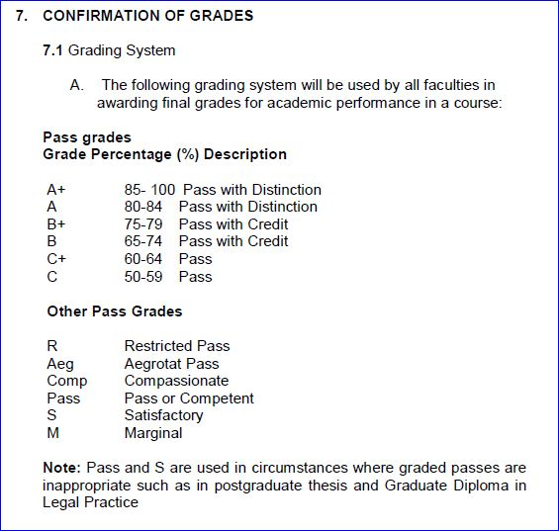
7) Understand the grade system.

Slide 7
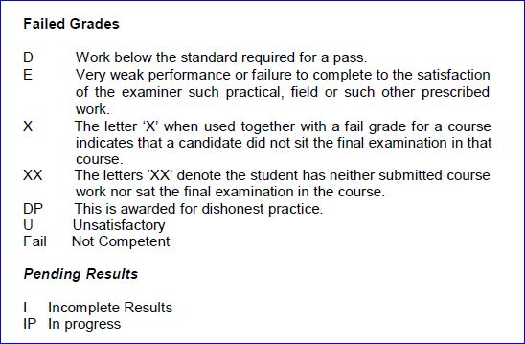
7) Understand the grade system.

Slide 8
Other Issues

Slide 9
Teaching Challenges
Image of the University
Infrastructure
- Lecture rooms
A/C
Tables and Chairs
Software upgrades
Students are given advice by teachers not to join UniFiji.

Slide 10
Solutions

Slide 11
Solutions
Comprehensive student orientation.
Putting optional student assessments where possible.
Continuous staff/students training programmes on IT, library facilities etc.
Satisfactory levels of infrastructure facilities and student services. E.g. SAS taking time to process applications.
Fees vs Quality of student services.
Take advantage of social media.

Slide 12
THANK YOU

