Slide 1
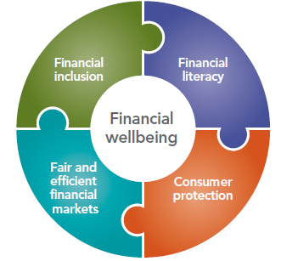

Financial Literacy
Amit Prakash
Asst. Lecturer in Economics
SOBE

Slide 2
Presentation Outline
Conceptualise financial literacy
Need for financial literacy
World data on financial literacy
Case studies
Countries response to need for financial literacy.
Conclusion

Slide 3

Conceptualise Financial Literacy

Slide 4
Need for Financial Literacy
Growth in the global economy
Complex
Financial ignorance carries significant costs

Slide 5
Consumers who fail to understand the concept of interest compounding spend more on transaction fees, run up bigger debts, and incur higher interest rates on loans (Lusardi and Tufano, 2015; Lusardi and de Bassa Scheresberg, 2013.)
They also end up borrowing more and saving less money (Stango and Zinman, 2009)

Slide 6
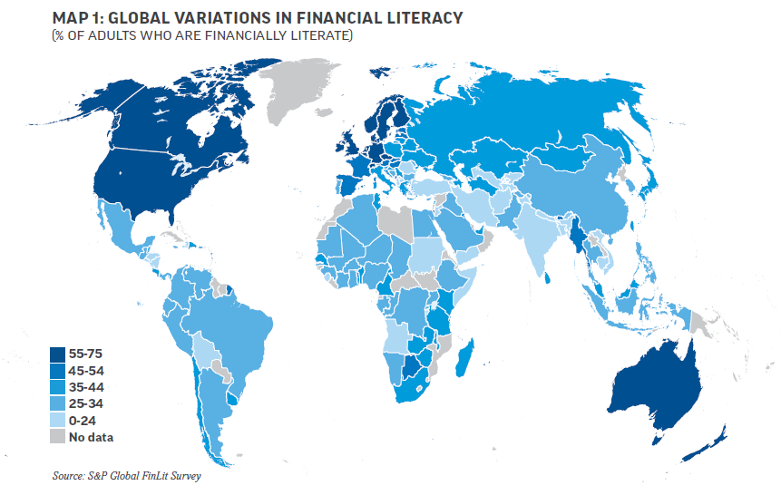
Global Data

Slide 7
Top 10 most financially literate countries in the world
1. Norway (71%)
2. Denmark (71%)
3. Sweden (71%)
4. Israel (68%)
5. Canada (68%)
6. UK (67%)
7. Netherlands (66%)
8. Germany (66%)
9. Australia (64%)
10. Finland (63%)

Slide 8
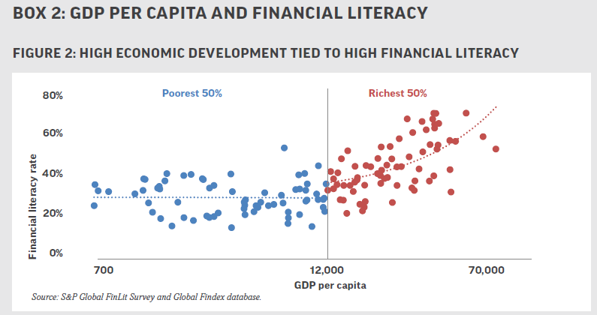

Slide 9
CASE STUDIES
In Slovakia, the country study found consumers were borrowing from unregistered consumer credit companies at effective interest rates of 120 and 229 percent per annum when they could have borrowed from banks at 14 percent of less. Worse still, if they missed a single payment or two, they could find their wages garnished and eventually would lose their homes—court order or no court order

Slide 10
In the Czech Republic, trying to prepay a consumer loan could result in a prepayment fee of 100 percent of the original loan amount.
In Croatia, the common complaint to the central bank was that, “We did not understand what we signed”. If they had co-signed a loan, consumers did not realize that they might be obliged to pay the debt of their friend or family member.

Slide 11
In Bulgaria, personnel of financial institutions are unable to explain to customers their financial products and if consumers had disputes over entries in credit register, correction of errors was difficult at best.
In Romania, borrowers received mortgage contracts printed in a 6-point font size that was too small to be read by anyone with less than perfect vision. Trying to obtain a copy of a contract before signing or finding out the amount of fees before sending the money was a test in patience

Slide 12
In Russia, over 400,000 investors had paid $1.4 billion to Ponzi schemes for investments that would never be repaid or apartments that would never be built. Over $60 billion a year is paid into stand-alone machines in subways and on the street to pay for utility bills, rent and other amounts under $1,000

Slide 13
Countries Response
Country | Response for Financial Literacy
Australia | Australian Securities and Investments Commission (ASIC). National Financial Literacy Strategy adopted in 2011. National Consumer and Financial Literacy Framework (2005). It articulates a rationale for consumer and financial education in Australian schools; describes essential consumer and financial capabilities that will support lifelong learning; and provides guidance on how consumer and financial education may be structured to support a progression of learning from Foundation–Year 10.

Slide 14
Country | Response for Financial Literacy
USA | Consumer Financial Protection Bureau (CFPB) inaugurated in 2011 and is solely dedicated to consumer financial protection. To empower consumers to take control over financial lives
Canada | Financial Consumer Agency of Canada (FCAC) established in 2001 by the federal government. FCAC role to strengthen oversight of consumer issues, expand consumer education in the financial sector, payment card network operators and their commercial practices and collaborate with stakeholders and coordinate activities that contribute to strengthening Canadians’ financial literacy.

Slide 15
Country | Response for Financial Literacy
Pacific Island Countries (PICs) | PFIP (Pacific Financial Inclusion Programme) is a Pacific-wide programme helping low-income households gain access to quality and affordable financial services and financial education. It is jointly managed by the UN Capital Development Fund (UNCDF) and the United Nations Development Programme (UNDP). PFIP aims to add one million Pacific Islanders to the formal financial sector by 2019 and currently reached 794, 557.

Slide 16
Country | Response for Financial Literacy
Fiji | A member of the Alliance for Financial Inclusion's Pacific Island Working Group. National Financial Inclusion Taskforce (Feb 2010) “Vuli the Vonu” – Fiji’s Financial Literacy Mascot National Financial Literacy strategy (2013 – 2015) Financial Education Curriculum Development (FinED)

Slide 17
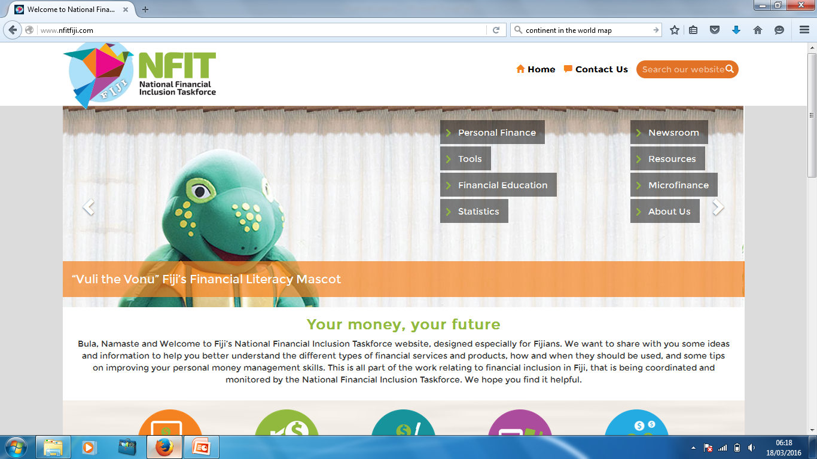

Slide 18
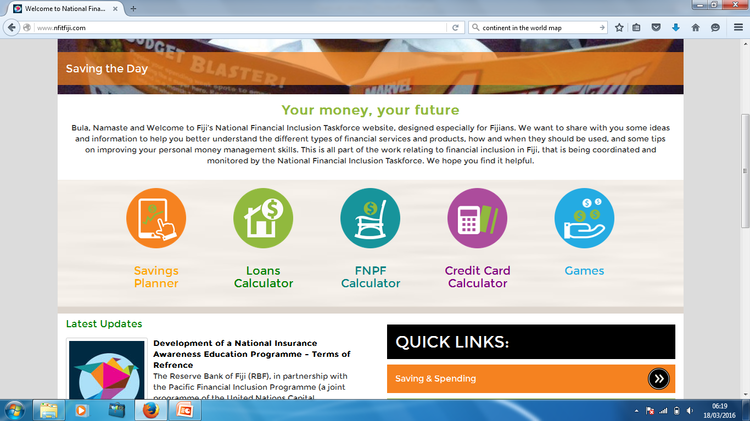

Slide 19
CONCLUSION
Financial literacy and financial inclusion are complementary.
The world economies are in a race to financially secure their population for the progress of the economy as a whole.
The Fijian government in collaboration with other respective partners is providing the platform for financial literacy – the onus are on us to became financially literate.
For a dollar today is worth much more than a dollar tomorrow – Time Value of Money

Slide 20

THANK YOU
“Vuli the Vonu” the Financial Literacy Mascot

