Slide 1

Centre for iTaukei Studies
Dr. Kuridrani
Ms. Rokuta
Mr. Gaunavou

Slide 2


Challenges
Student inclusion & retention.
Student engagement
Client Satisfaction
Industry Collaboration with government & civil society organizations.

Slide 3
Challenges
Interdisciplinary teaching(for example: indigenous studies, law, health)
IT support (facilities / equipments) for teleconferencing

Slide 4
Challenges
Internationalization of our programs with other indigenous studies centers in Australia, NZ, Hawaii, Canada and Caribbean.
Library should effectively support out teaching & learning program.
Resource & exhibition Centre
Community engagements
Greatest challenge is how best we can make these dreams /visions happen.

Slide 5
Social Behavioral Strategies for Intervention
A) Students
Introduce a Student Services Manager who looks after all Student Affairs.
Student Association Office.
Counseling Committee (refer chart)
Cultural Night / CIS – exhibition of cultural dance , songs and artifacts.
Inter- school sports day.
Inter-tertiary sports.
Exchange programs with Otago, Massey University, NZ, Hawaii (Hands on Practice & Research )

Slide 6
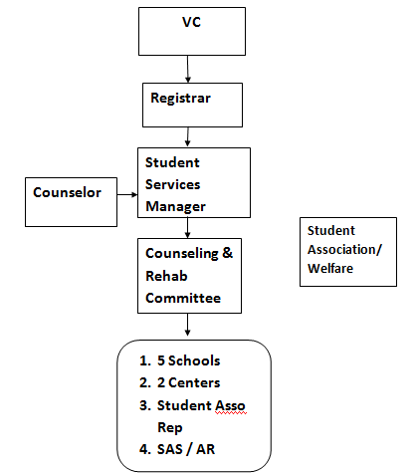

Slide 7
A) Students
Vale ni Bose
Protocol Officer.
Community projects- social responsibility
Residential Units for Students local & overseas:(Cafeteria, laundry, pool, Fitness Centre, Therapy Services, Medical Centre, Recreational Room, Market)

Slide 8
CIS Graduates
Primary & Secondary School Teachers = 90%
ITaukei Trust Fund - 2
Bred Bank - 1

Slide 9
Strategies for Intervention
b) Staff
Revive Staff Association/ Welfare.
Invent champions in specific areas- sports, social club, research, local & international conferences
Family Sports day
Staff Insurance
Additional Staffing

Slide 10
Rule of the Game:
We will create a demand for Business in Creativity & Innovations
We will not wait and idly wish for Mana to fall
We will make Mana fall through our creativity & innovation
Stay Blessed

